Slide 1
Implementation of LACE Framework for Prediction of Readmission Within 30 Days
Cordier B., Hee D., & Swan R.
Notes:
Good Morning, thanks for being here for our presentation on the results of our investigation about LACE

Slide 2

Roadmap
Outline issues facing Hospitals
LACE score
Examination of LACE model
Possible extensions to LACE
Recommendations and Future Actions
Wikimedia Commons
Notes:
Outline issues facing Hospitals
Brief introduction to the LACE score
Examination of LACE model
Possible extensions to LACE
Recommendations and Future Actions

Slide 3
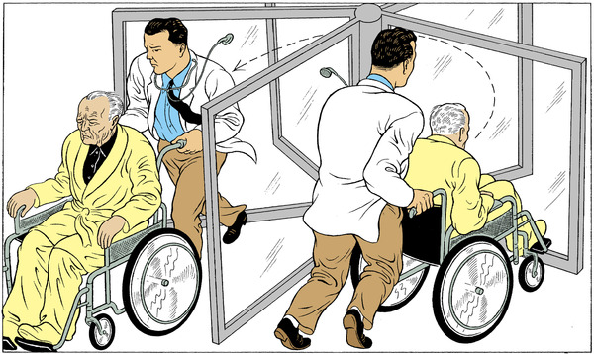
Problem Statement
Goals:
Reduce the number of hospital readmissions
Keep mortality rates low
How can we best manage these competing concerns?
Credit: Tim Lane
Source: http://www.nytimes.com/2009/12/01/health/01essay.html
Notes:
Some of the pressing concerns facing hospitals are unanticipated, but preventable, readmissions.
These are usually directed towards the Emergency Department
Not only is that a high cost for the hospital, but there is also a high cost for patients as well
Our goal with this project was to find a way to reduce the number of readmissions while maintaining quality of healthcare for our patients.
What is the best method for managing these competing concerns

Slide 4



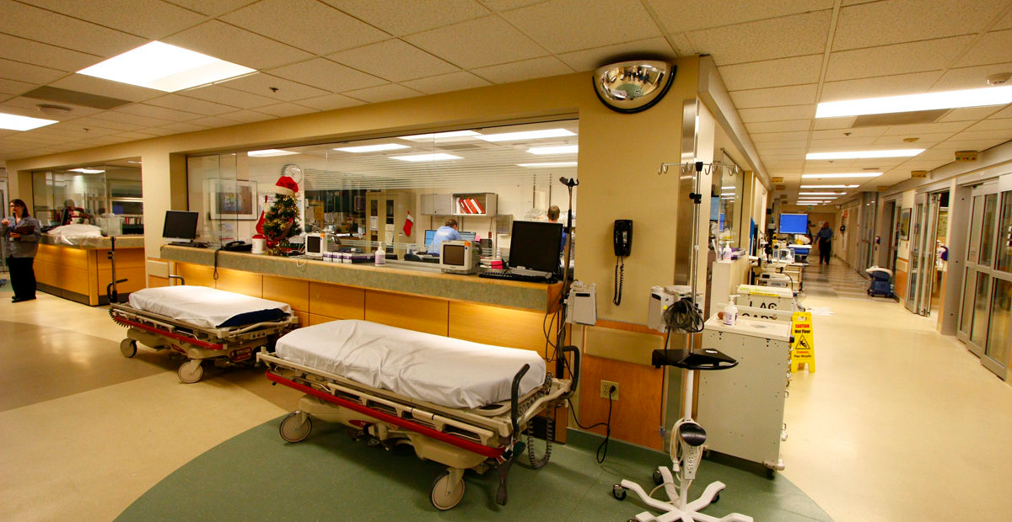
L
A
C
E
Model
(L) https://archive.ahrq.gov/news/newsletters/research-activities/13sep/0913RA9.html
(A)http://koin.com/2014/09/15/ohsu-police-force-now-armed/
(C)https://healthawarenessfoundation.com/why-do-i-age-get-sick-get-diseases/
(E)http://www.inline-cc.com/portfolio-view/in-tempus/
Notes:
Love the layout ; )
In order to address this problem, we look to LACE which is used to identify Individuals at risk of unplanned readmission
LACE is a combination of predictive metrics(cofactors)
L - Length of stay (Scaled)
A - Acuity of Admission (Emergency Room or not, binary)
C - Comorbidities (Translated to a Comorbidity Score)
E - Emergency Department Visits (Excluding preceding visit)
Captures the risk of a potentially avoidable rehospitalization
Benefits Easily calculated and updated at each hospital event Intuitive as a risk scale to clinicians
We can leverage this simple measure in order to predict which patients are the highest risk of readmission by building a model based on variables that may contribute to readmission.
Current implementation of LACE used a threshold of 11 to define individuals at high risk; our goal was to develop a model that performed better than that.
Patient in bed (L) source: https://archive.ahrq.gov/news/newsletters/research-activities/13sep/0913RA9.html
Emergency v normal @ OHSU (A) source: http://koin.com/2014/09/15/ohsu-police-force-now-armed/
Comorbidity © source:https://healthawarenessfoundation.com/why-do-i-age-get-sick-get-diseases/
ER OHSU source: http://www.inline-cc.com/portfolio-view/in-tempus/

Slide 5
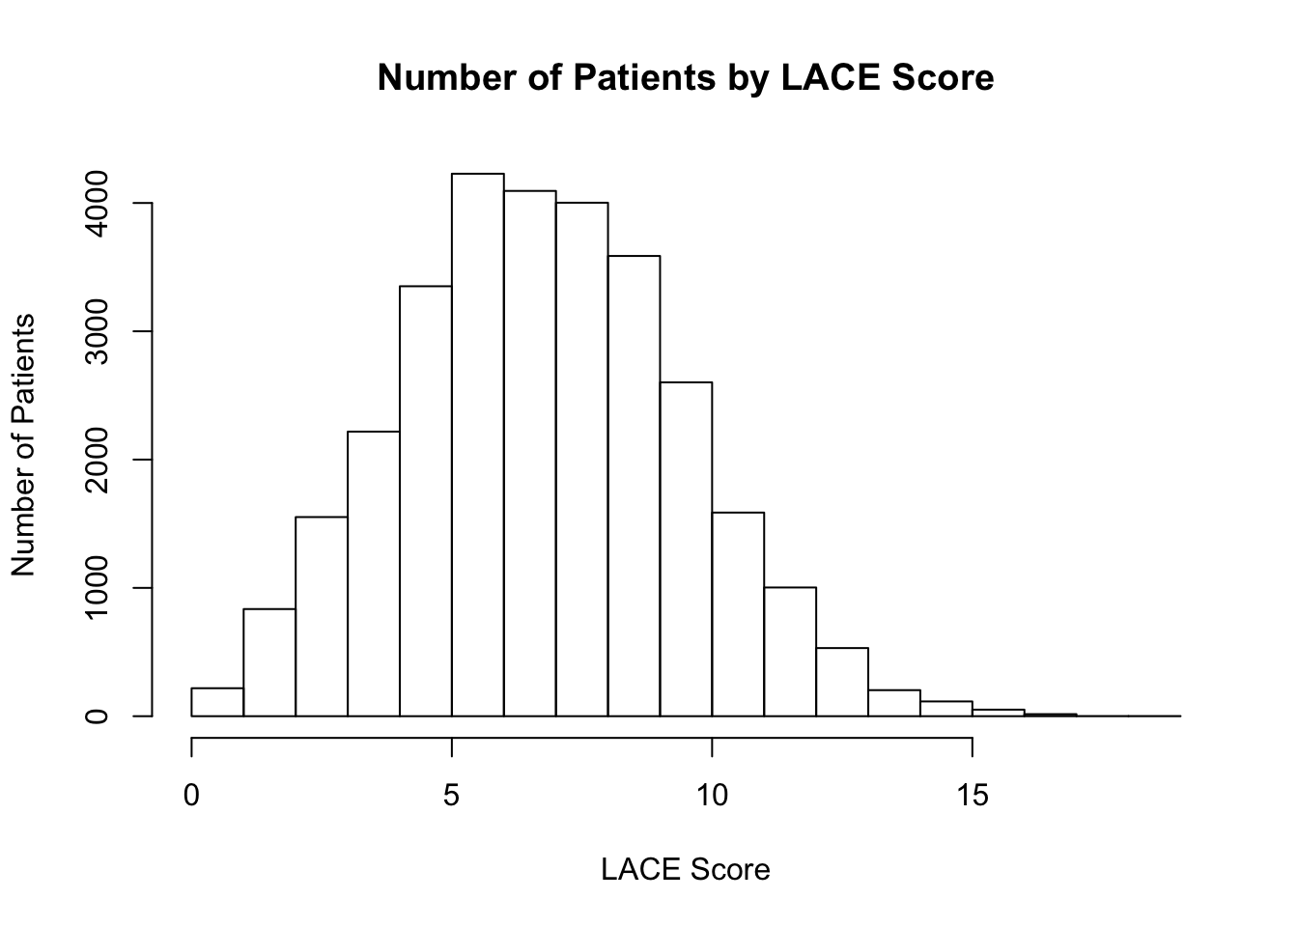
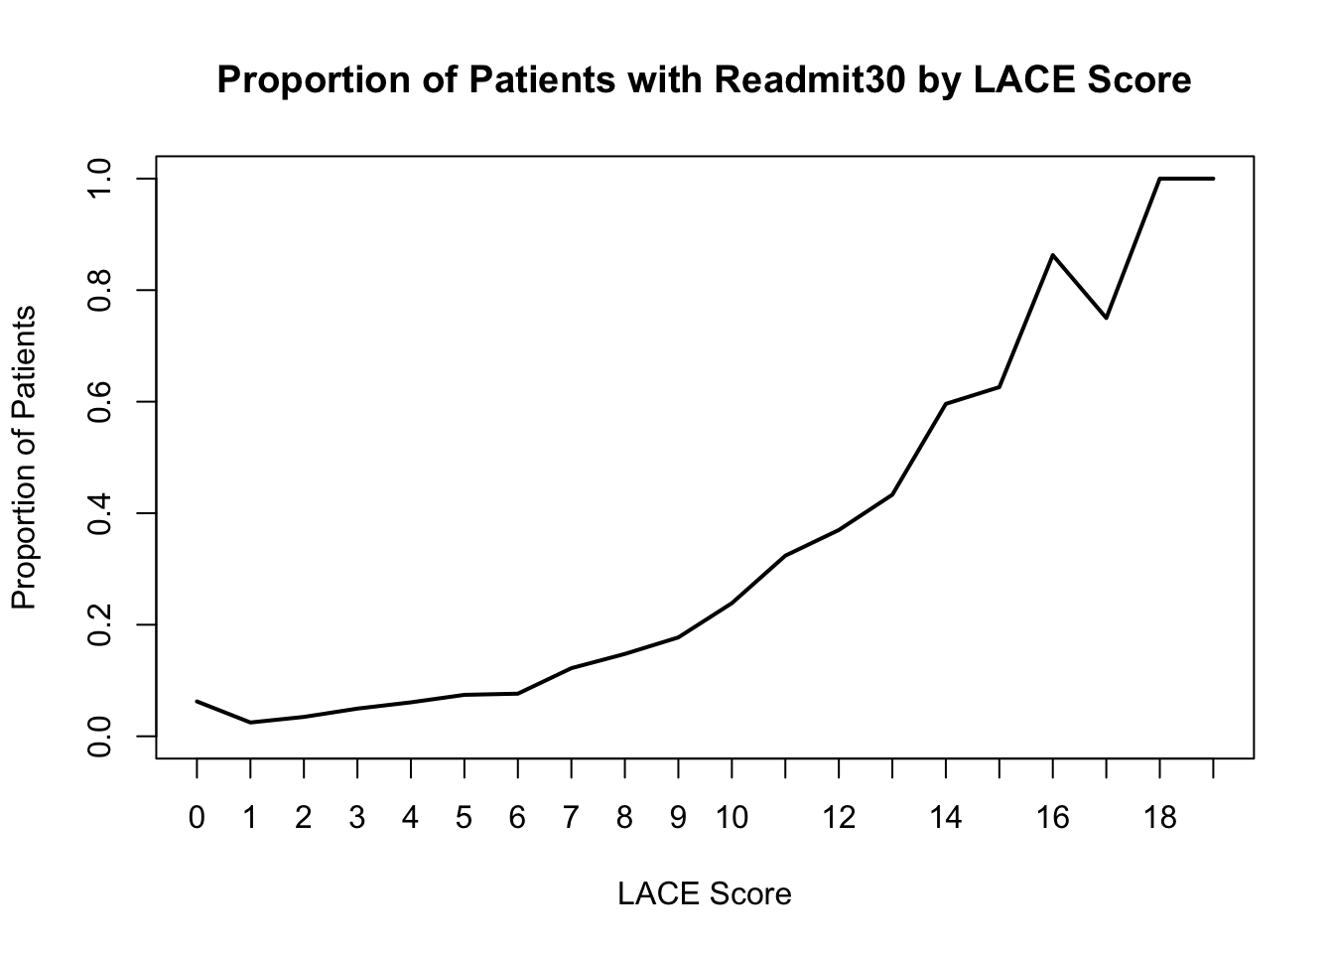
Data Overview
Notes:
We have evidence that our population is similar to the establishing paper’s population
Update with script?
Threshold - 0.215 (increments of .005)
Specificity -
Sensitivity - 91%
Accuracy - 81%
False Positive -
(Individuals w/out problems, overcharging because additional unnecessary visits)
False Negatives(individuals die at home, hospital liability)

Slide 6
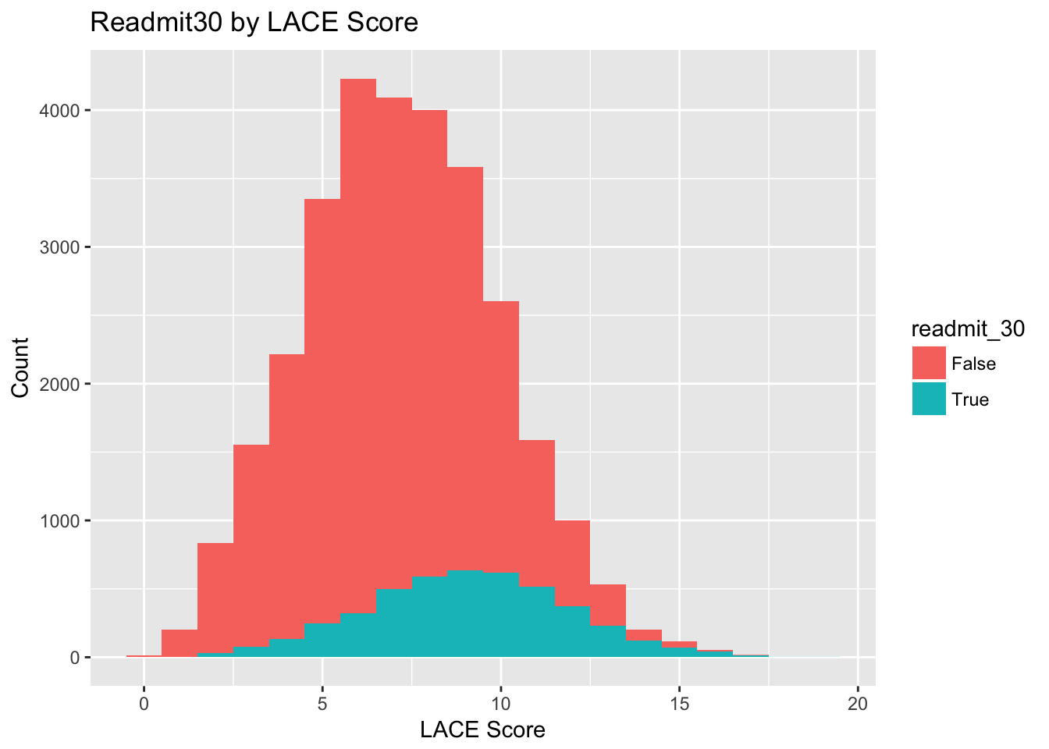
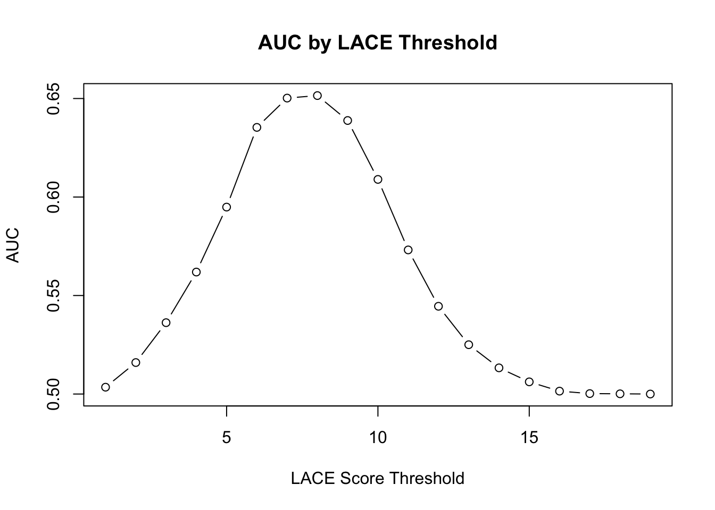
Challenges of Thresholding By LACE Sum
Observed AUC values show very low sensitivity and resulting AUC at the suggested “high risk” threshold of LACE = 11.
Is summation of scores insufficient to take full advantage of information provided by comorbidities and other indicators?
We evaluated logistic regression and other methods be used to enhance predictive power of the model.
Notes:
AUC values were relatively low by LACE score for the model and exhibitied relatively low sensitivity for the ‘high risk’ cutoff of a LACE score of 11.
In examining the LACE model, our basic question was: Can we do better modeling readmissions at 30 days with individual L, A, C, and E values than modeling readmission at 30 days with the LACE score (summed L,A,C, & E)
We evaluated

Slide 7
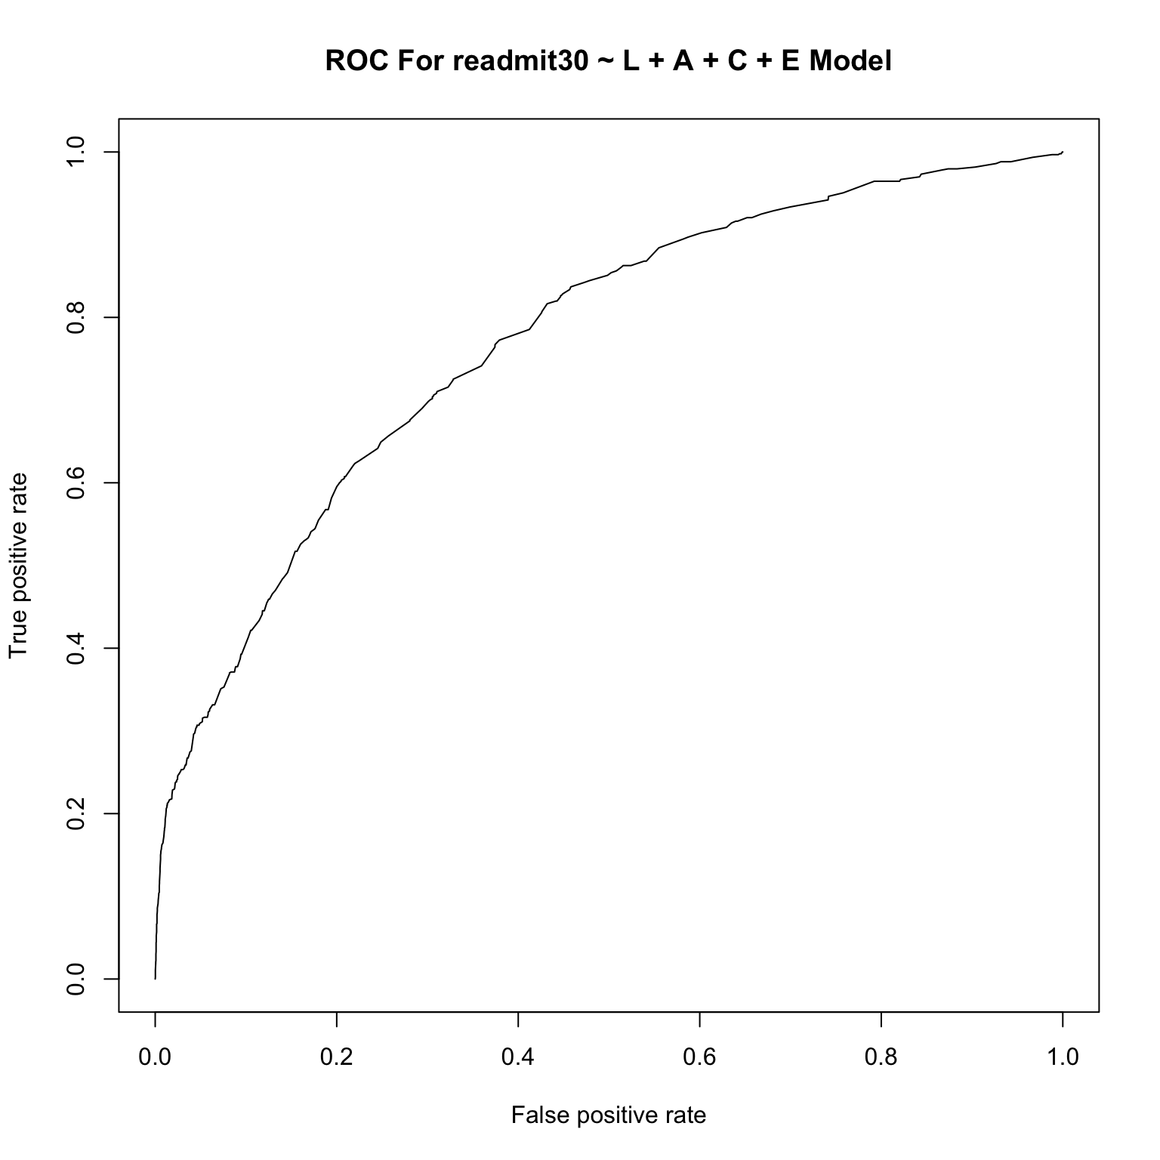
Logistic Regression
Model
Comorbidities Included:
Diabetes
Myocardial Infarction (MCI)
Dementia
Depression
Stroke
Hepatitis C
Asthma
Congestive Heart Failure (CHF)
Coronary Artery Disease
Peripheral Vascular Disease
AUC = 0.7711
Notes:
Model selection of full model L, A, C, E, Lace Sum
We can pick a model by setting a threshold on the modeled probability of a readmission within 30 days.
To set the threshold, we selected three use cases and corresponding statistics we would hope to emphasize in each use case.

Slide 8
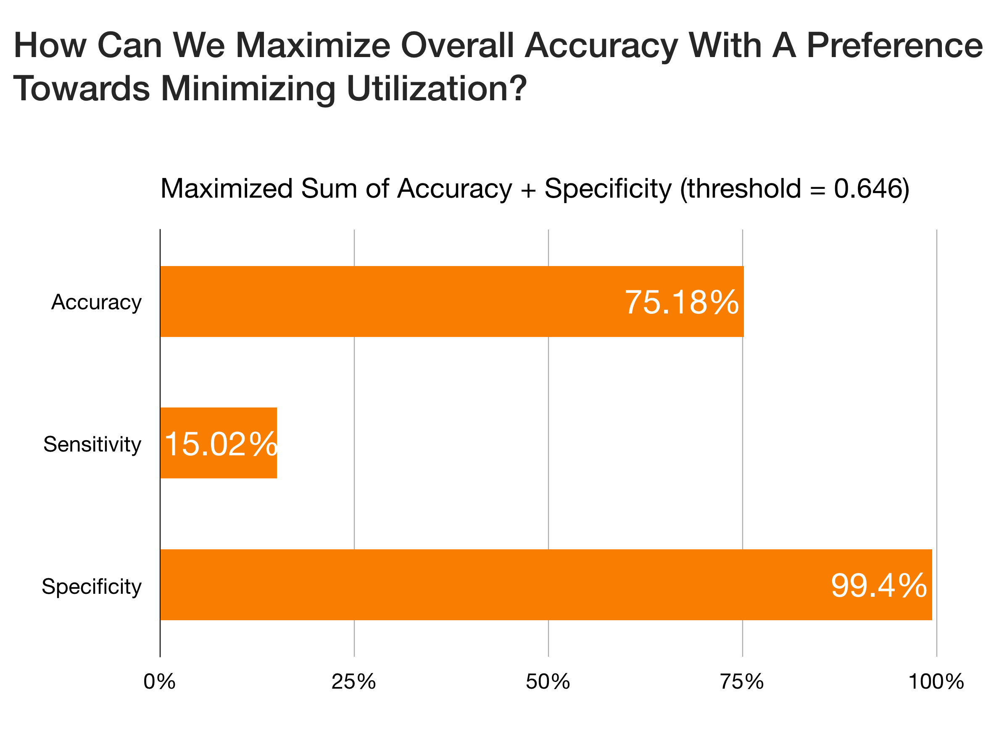
Notes:
\

Slide 9
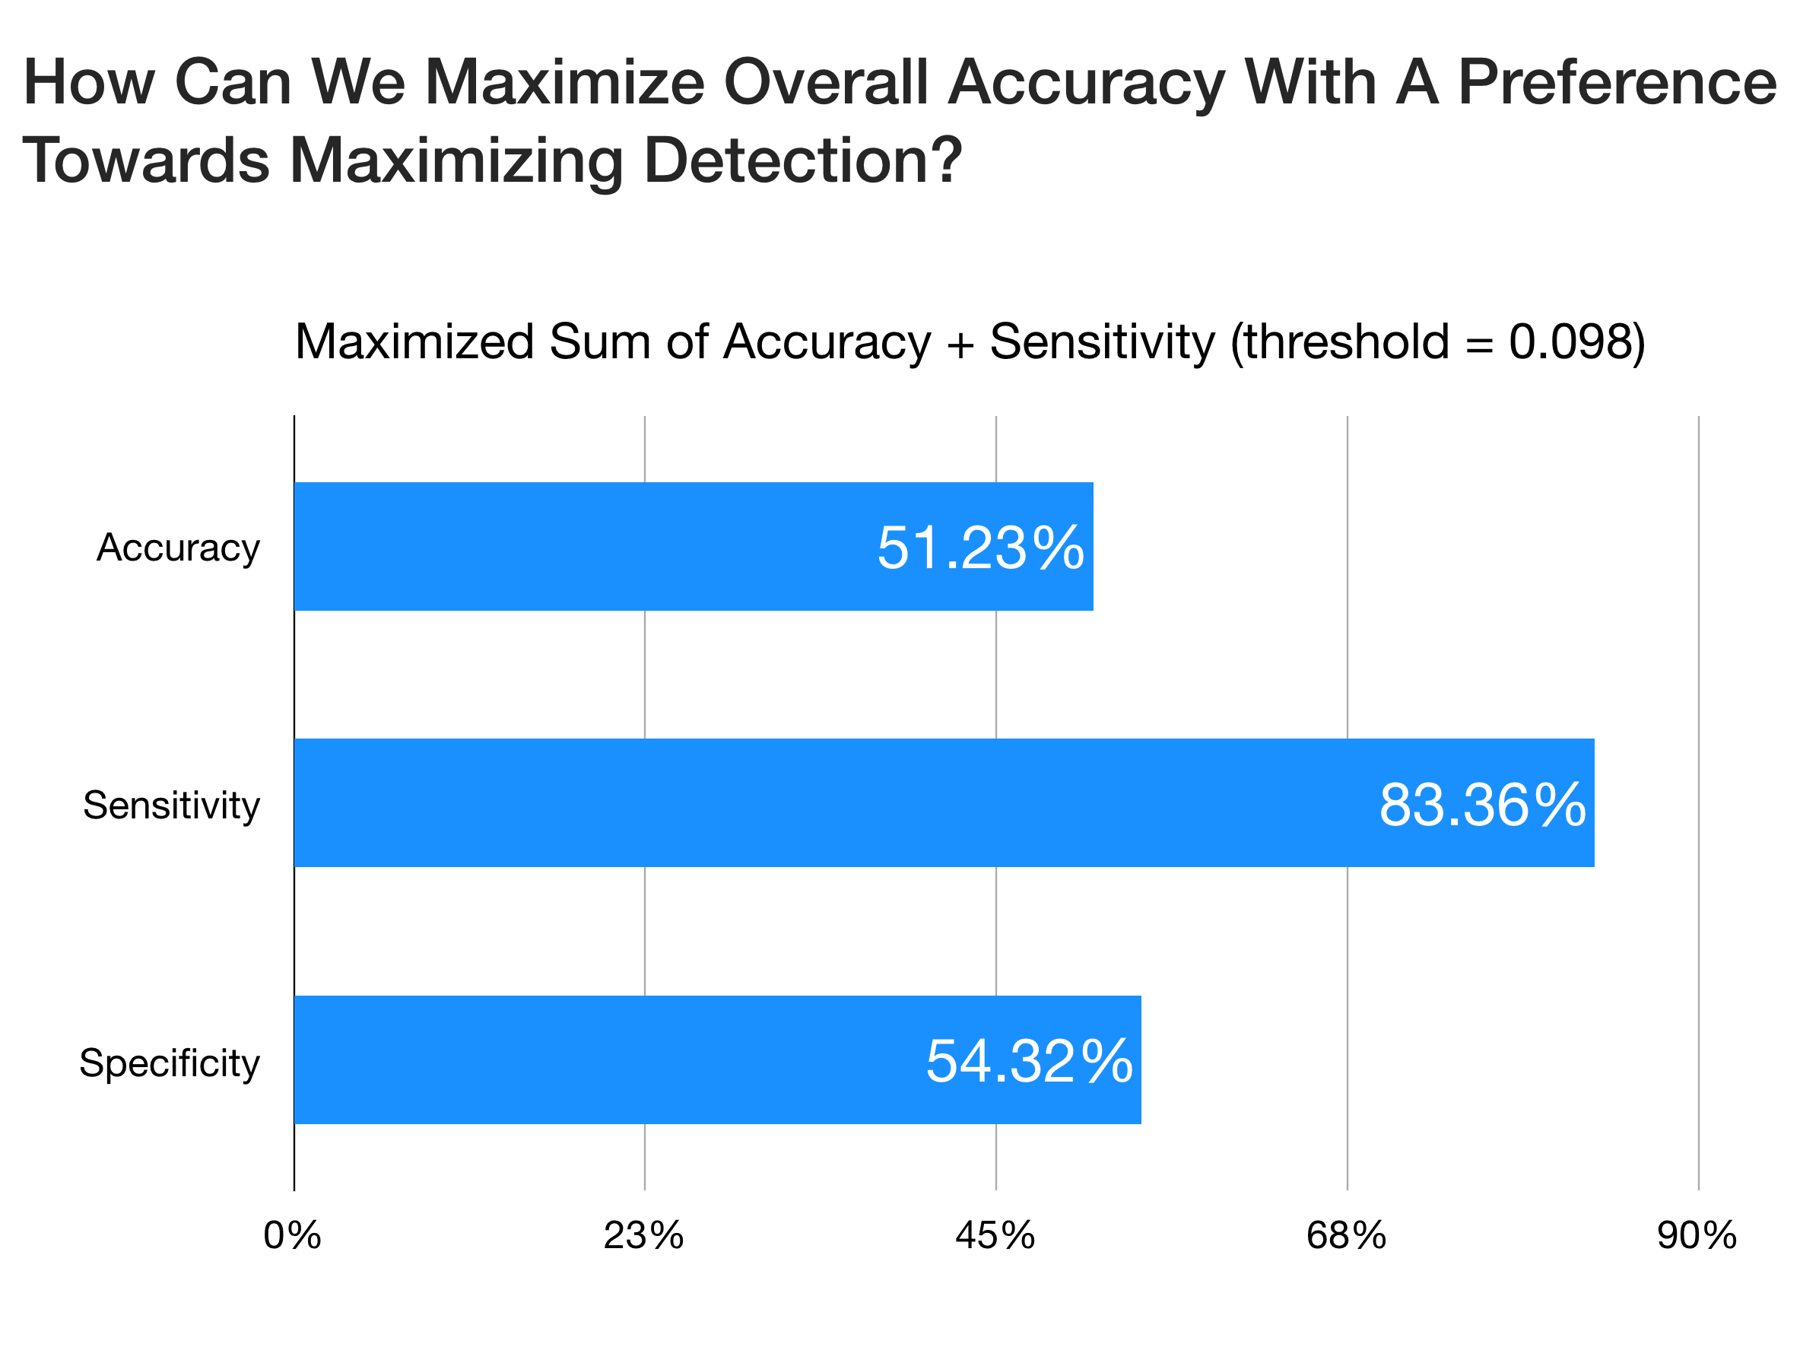

Slide 10
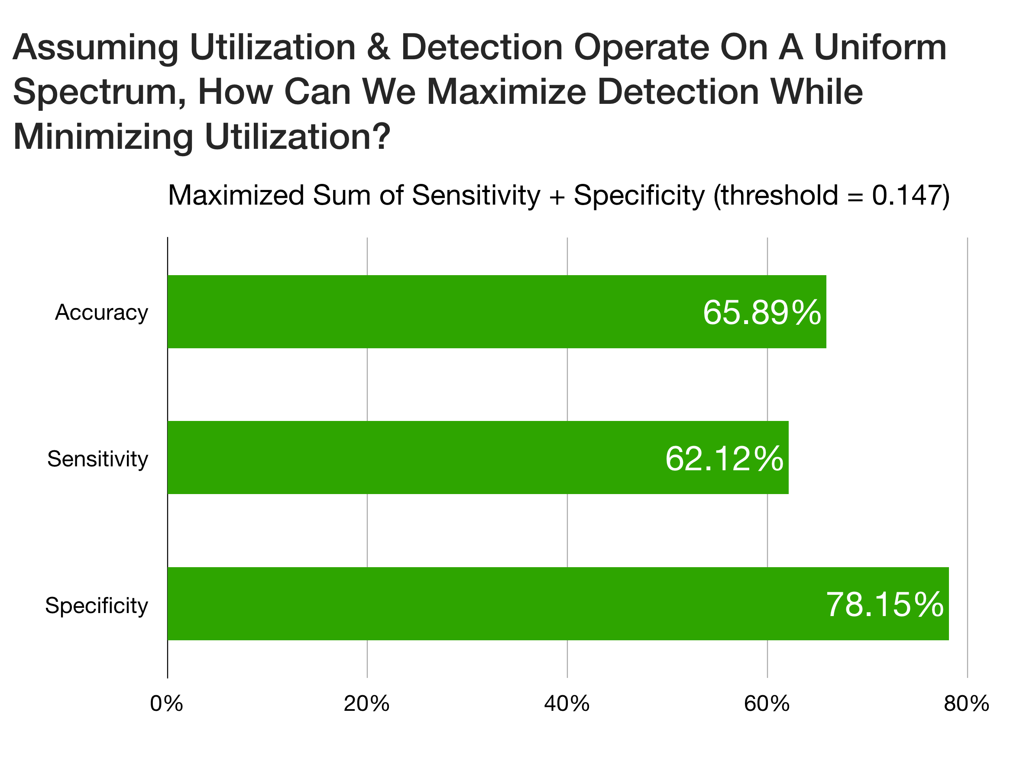

Slide 11
Extensions
LACE with weights on comorbidities
Examine more nuanced approaches to weighting comorbidities
Machine Learning Methods
Attempted naive SVM, but performance was inferior to logistic regression model
Possibly useful to further dissect high risk group with additional covariates
Additional information for patients for whom intervention is pursued after high-risk diagnosis
Alternatives to Readmit30
Alternative time points to account for differences in disease progression
Time Series Analysis

Slide 12
Caveats
Model interpretation more complex than traditional LACE
Naive method of setting a threshold performs slightly worse than model, but is much simpler
We did not use all of the comorbidities that were taken into account in the traditional LACE score (ex: previous Myocardial Infarction). We also removed weights for C to use occurrences of comorbidities.
Did not use weighted C model (simple sum of n comorbidities)
Weighting scheme for C not significant in model
Notes:
We can explain the lack of significance in our weighted C score as a lack of domain knowledge

Slide 13
Conclusions
LACE shows promise for identifying high-risk patients who can be targeted for intervention before a subsequent hospitalization
LACE in its most basic formulation works well, but augmentation with more complex methods, specifically a logistic model balancing clinician and administrative needs, may provide additional gains to model effectiveness
High levels of false positives may be sustainable if the costs of intervention are less than those prevented by avoiding future ED hospitalization
Win-Win scenario of better health outcomes for patients and better bottom line for stakeholders
Notes:
Future Directions: 4. Can also find ways to save patients money

Slide 14
Questions?

Slide 15
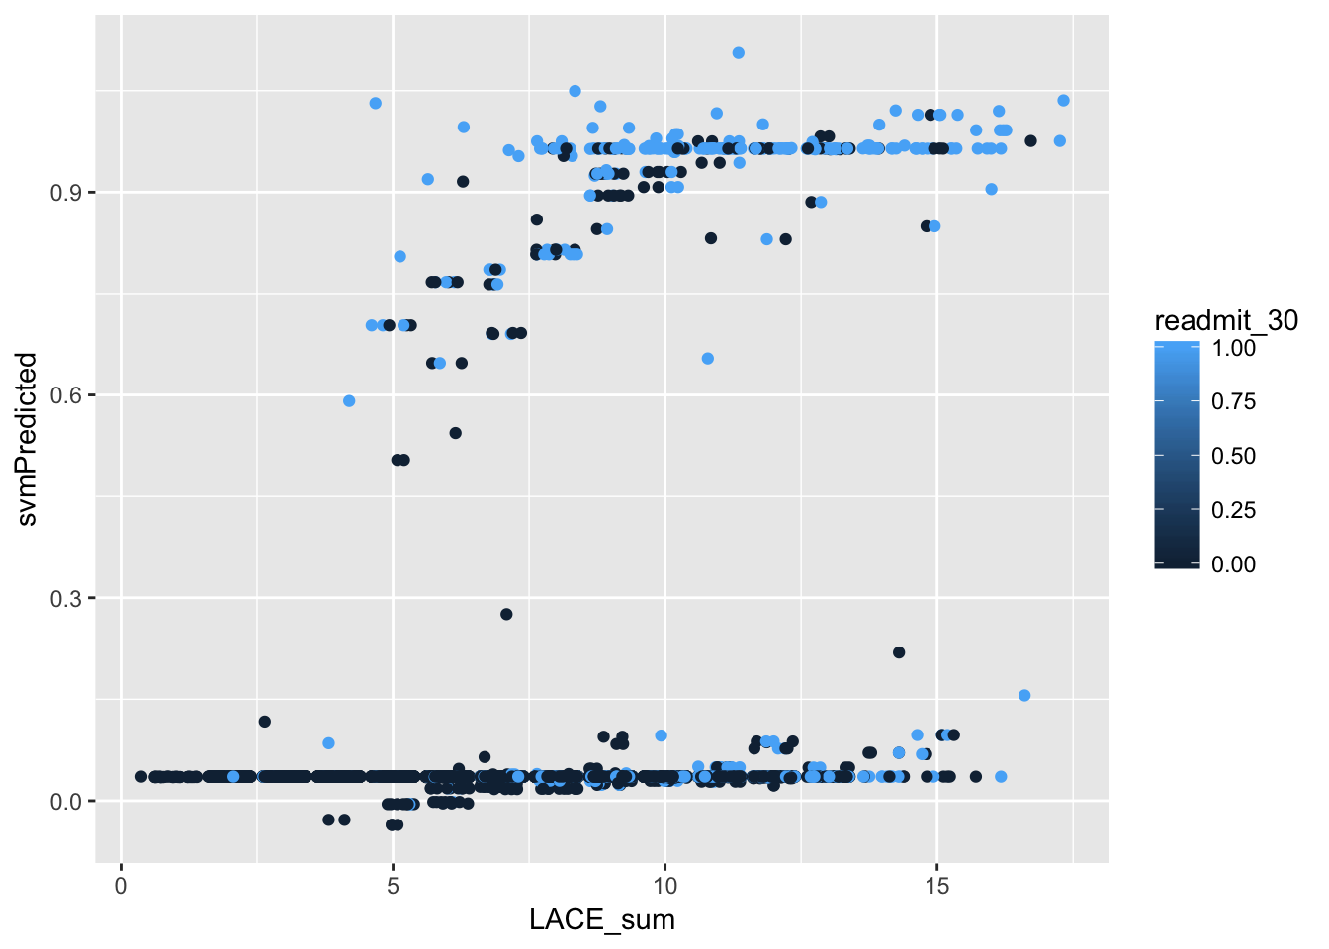
Extra - SVM
An SVM trained on a radial kernel showed comparable performance to the thresholding method (AUC=0.61).
In cases where interpretability is not of the highest concern, machine learning methods may have the ability to augment the existing formulation of LACE.

